Slide 1

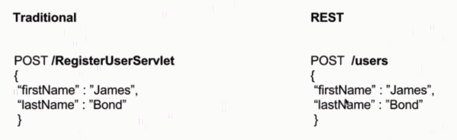
Resource and Collection URI

Slide 2

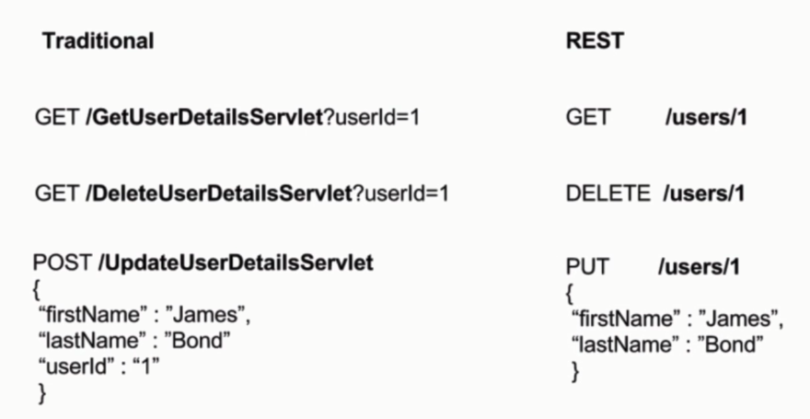
Resource and Collection URI

Slide 3
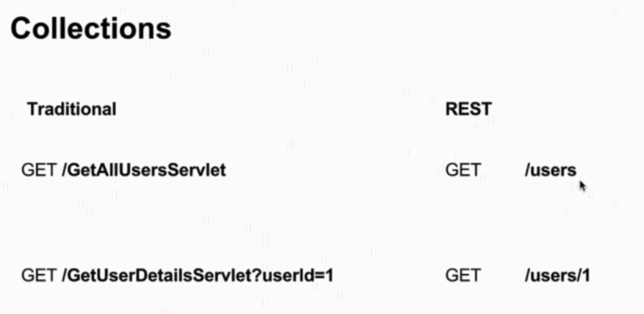
Resource and Collection URI

Slide 4
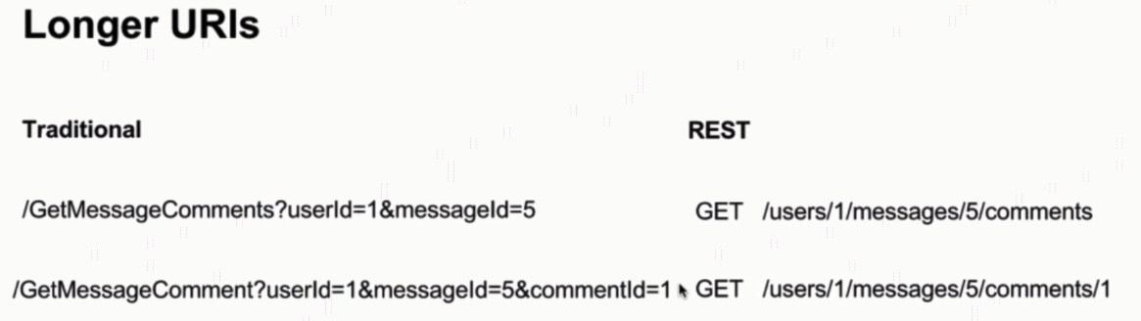
Resource and Collection URI

Slide 5
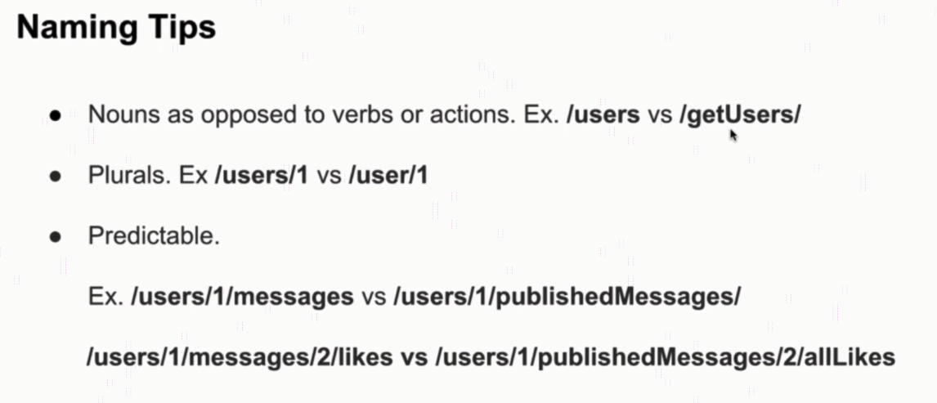
Resource and Collection URI

Slide 6
Postman Overview
https://www.udemy.com/course/restful-web-services-with-spring-framework-a-quick-start/learn/lecture/11769760#overview

